Slide 2
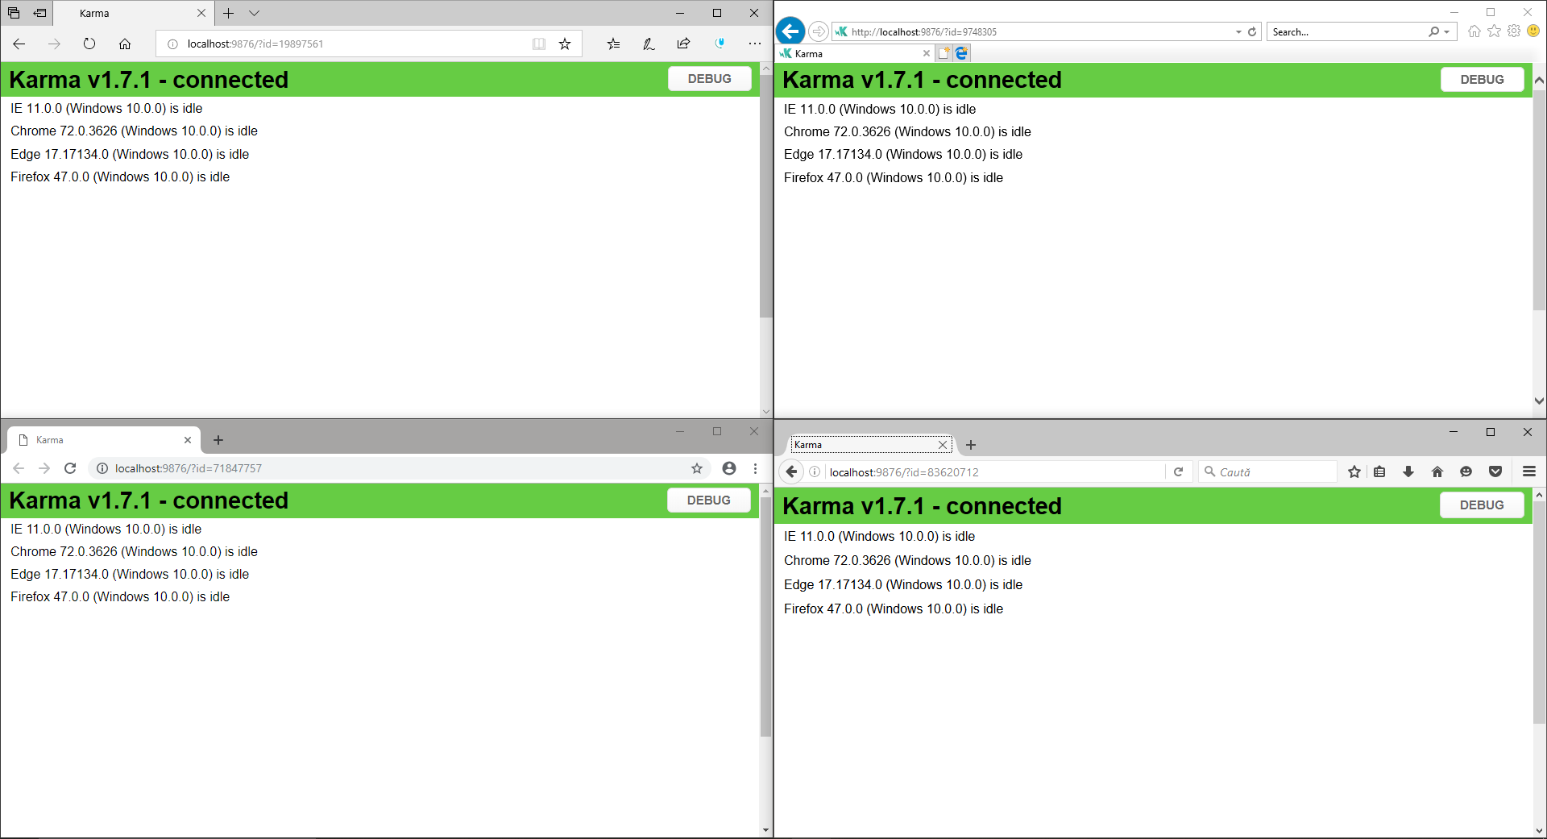





Slide 3
module.exports = function (config) {
config.set({
browsers: ['Chrome', 'Edge', 'Firefox', 'IE'],
frameworks: ['browserify', 'jasmine'],
files: ['test/unit/**/*.js'],
reporters: ['spec'],
preprocessors: {
'test/unit/**/*.js': ['browserify']
},
browserify: {
debug: true,
// needed to enable mocks
plugin: [require('proxyquireify').plugin]
},
// if you want to continuously re-run tests on file-save,
// replace the following line with `autoWatch: true`
singleRun: false
})
}

